Slide 1

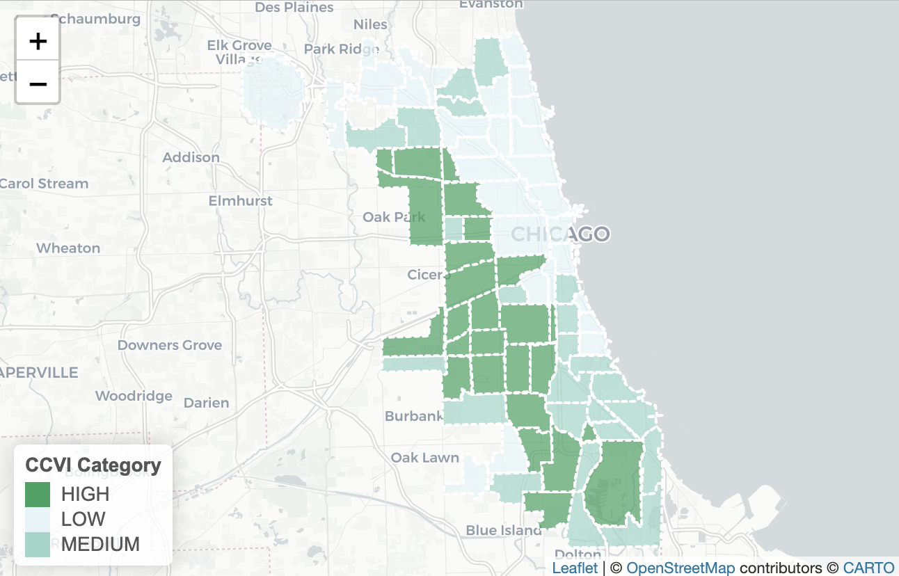
In the space below to copy/paste/insert a custom version (new color palette) of Figure 1 (map of CCVI Scores by Community Area) from the exercise.
GEO 3330 Sustainable Urban Transportation
Exercise #2: L Station Ridership Trends
Describe here any patterns you see in the map. Use data from the map to describe characteristics of at least one community located within each of the three CCVI categories.
The outer community areas have a higher transmission rate. The South and West sides of the city have the highest transmission rates. South Deering has a high rate of transmission rate: it ranks at 67 for socioeconomic status, 17th for essential workers, and 56 for mobility ratio. West Ridge has a medium transmission status: Ranks at 35 for socioeconomic status, 55 for essential workers, and 26 for mobility ratio. Uptown has a low transmission rate: 20 for socioeconomic status, 37 for essential workers, and 10 for mobility ratio.

Slide 2
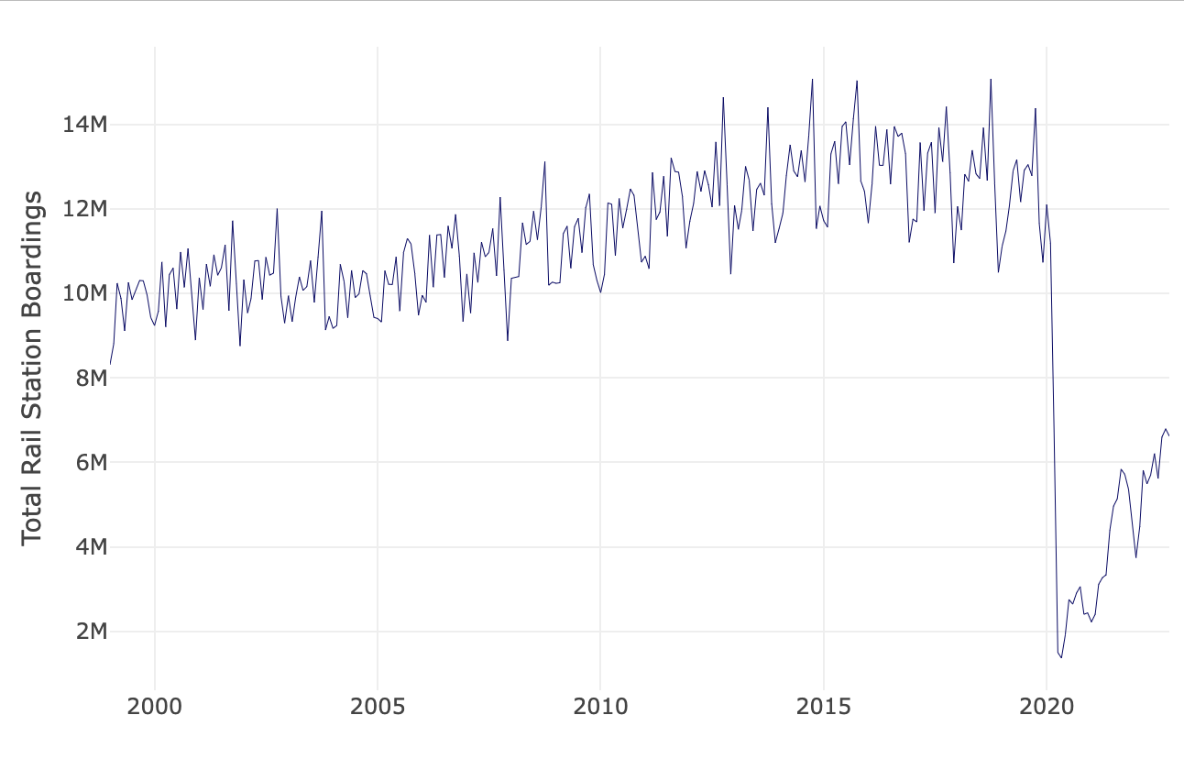
In the space below to copy/paste/insert Figure 2 or 3 from the exercise.
GEO 3330 Sustainable Urban Transportation
Exercise #2: L Station Ridership Trends
Describe patterns in rail boardings between 1999 and 2022. What do you think explains some of the cyclical variations in the data? What other factors may explain ridership over this period? Draw from the daily ridership plot to characterize ridership trends during the pandemic.
The data spikes up and down during the year period. Ridership increased until 2020, when the pandemic began and ridership decreased significantly. The cyclical patterns pre-pandemic could be due to the seasons, with ridership possibly decreasing in the winter as temperatures drop. Ridership may have increased between 1999 and 2020 due to the CTA making improvements or less people driving. During the pandemic ridership decreased at the very beginning when less was known and many offices and businesses closed. Ridership increases a bit as places reopen, but decreases eventually as another surge may have occurred. As vaccines roll out many more places stay permanently open and people return to the office, workplace, school, and social gatherings.

Slide 3
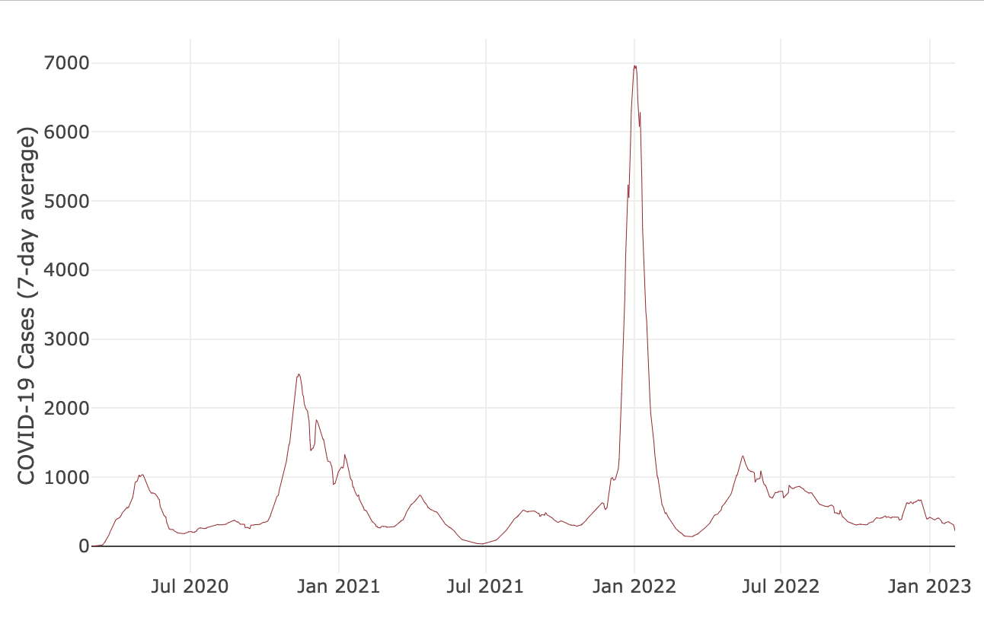
In the space below to copy/paste/insert Figure 4 from the exercise.
GEO 3330 Sustainable Urban Transportation
Exercise #2: L Station Ridership Trends
Are the waves and phases of the pandemic evident? Compare these pandemic phases to ridership trends over the same period. Do they appear to be related?
Yes it is possible to view the surges in cases and also the effect of vaccines as they began to get distributed. Ridership tends to follow this trend as it increases when cases are low and decreases when cases are high.

Slide 4
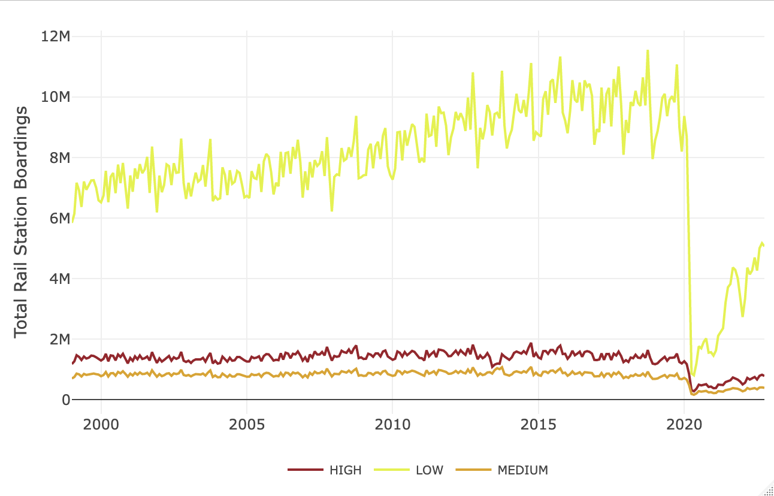
In the space below to copy/paste/insert Figure 5 or 6 from the exercise.
GEO 3330 Sustainable Urban Transportation
Exercise #2: L Station Ridership Trends
How does ridership vary with respect to station CCVI and line?
In areas with low CCVI, ridership bounced back much faster than with high and medium CCVI status. Lines that go through areas with high or medium CCVI status also were much slower to regain ridership than lines that go through areas with low CCVI areas.

Slide 5
Summarize some potential short- and longer-term implications the pandemic has had on sustainable transportation and public transit ridership?
Short-term ridership decreased and increased as the pandemic had surges and then lower rates of cases. Long-term ridership of transit has yet to increase to pre-pandemic levels, with more people working from home and also finding other means of transit like driving or biking. With less people taking public transit and more people driving, this practice is not sustainable for the planet.
GEO 3330 Sustainable Urban Transportation
Exercise #2: L Station Ridership Trends
What strategies do you propose to help return transit to pre-pandemic levels?
Due to CTA staffing shortages, there have been fewer trains and busses in service. In order to increase ridership the CTA needs to become dependable and operate on a regular schedule with reduced wait-times and delays.

